Slide 1
Sports Betting
By: Samer Arbaji, Miguel Diaz, Glenn Macapinlac, Kshitij (Shawn) Desai

Slide 2
Why Sports Betting?
We are all sports fans, and were curious about the world of sports betting.
Wanted to dive a bit deeper and get a better sense of how accurate bookies actually were when making odds or picking who wins.
At the moment our group specifically focused on the sport of soccer.

Slide 3
Questions
How accurate were bookies when picking winners?
How confident were bookies on every sports matchup across the European soccer leagues?
Did the bookies buy into the home field advantage? How often did they pick the home team and how many times were they right?
Was there a relationship in odds whether a team was home or away?
How did the odds move before kick off?

Slide 4
Data Sources
To properly answer our questions we had to find datasets that offered us information on bookies, odds, match results and different soccer leagues.
Kaggle: We were able to find most of our data sets from Kaggle. We pulled multiple CSV files that had the information we were looking for to properly answer the questions.

Slide 5
Data Clean-up & Exploration
Even though we were able to find CSV files they were raw, and required us to clean them up a bit.
We had to merge a couple CSV files as one had match odds and the other had the match results. If they were separate it would have been no use to us.
We were unable to find an API that gave us information on sports betting during our search.
One issue we had encountered during cleaning and exploration was the data wasn’t complete for all leagues.

Slide 6
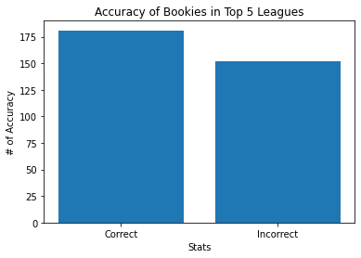
Data Analysis: How accurate were bookies?

Slide 7


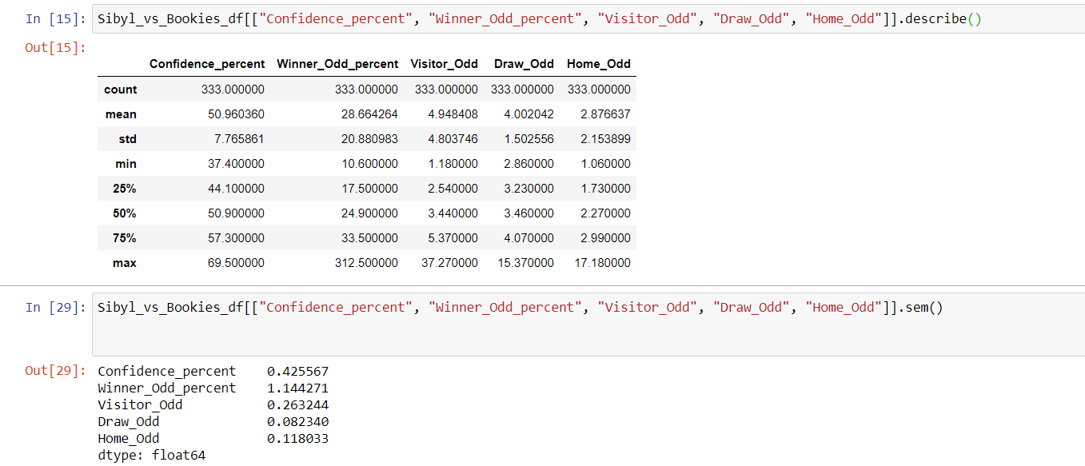


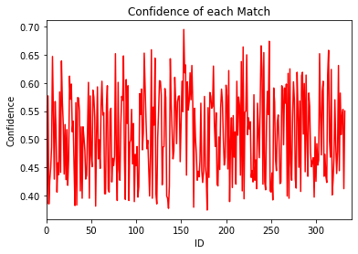
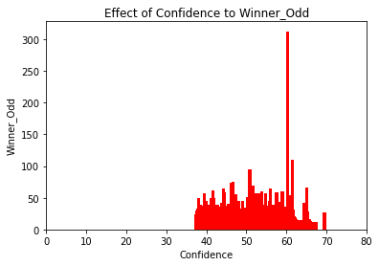

Confidence of bookies for each matchup?

Slide 8
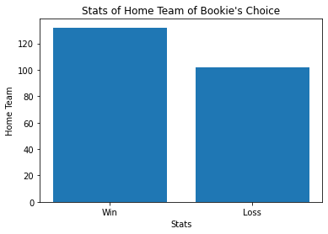
Home Advantage?

Slide 9
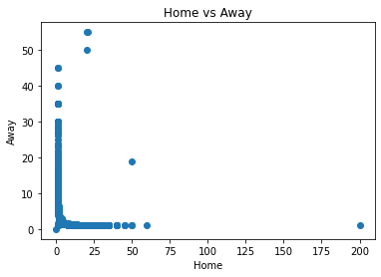
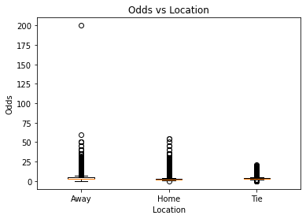
Relationship of odds between home and away teams?
The correlation was -0.3277

Slide 10
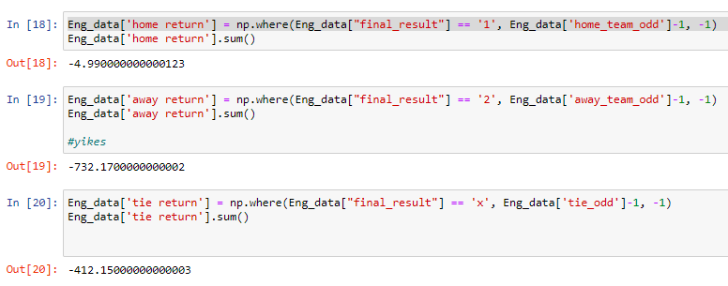
Cool, but can we make money from this?
We know that home teams have an advantage, and we also know the effect of bookie confidence.
Simulated the simple strategy of betting for every home team vs every away team game vs every tie (5552 betting lines total)

Slide 11
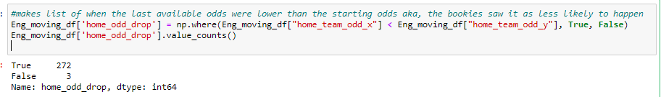

Cool, but can we make money from this? (Cont)
bookies odds for the home team went down by game time in 272/275 (or 98.9%) in the Eng sample.
So what if we bet every single first home odds available?

Slide 12
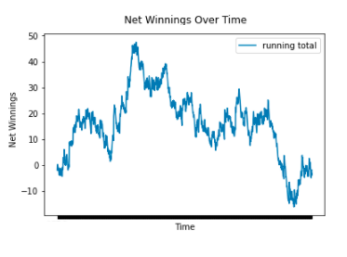

Did this result hold for the across the top 5 leagues?
After 1386 one dollar bets over a one year period we’re ever so slightly in the red.
Of note the finding of home team odds having their odds deflated the close one got to game time occurs less often in the other leagues. (1058/1111 or 95.2% of the time)

Slide 13
Discussion
After our analysis we were able to answer our questions as well as we hoped.
From our findings bookies are generally consistent. They are right generally as much as they are wrong.
Basically sports is sports, anything can happen. You can follow a bookies odds or their choices and more times than not they are right. But they are wrong a lot as well.
In fact seeing how close to even we can get with very simple betting strategies, there’s hope for getting an advantage over them with more data and more wrangling.

Slide 14
Conclusion
The biggest difficutly we had found during this project was finding whole data sets. A lot of the data we had found was for partial seasons, so while it was enough to answer the questions it wasn’t for full seasons.
If we had more time we would try to explore more sports and find if they were similar to soccer. Were bookies right more in different sports? Did other sports bet more?

Slide 15
Questions?

